Slide 1
Psychological approach to Tojisha Kenkyu studies of people (diagnosed) with mental illness Tomoe Kodaira¹, Takehiko Ito² ¹Seirei Christopher University, Hamamatsu, Japan ²Wako University, Tokyo, Japan PS25P-14-398, Exhibition Hall Poster 4, Pacifico Yokohama Poster presentation in ICP2016 p.231 16:30-17:30, July 25, 2016

Slide 2
Problem: What is Tojisha Kenkyu (Self-directed research)?
Tojisha Kenkyu was born from daily activity of Bethel （social welfare cooperation located in Urakawa Town, Japan) members who suffer with schizophrenia and other mental disorders.
Research topics or themes are mainly from daily issues that the clients (and their family members, and sometimes supporters (social workers, nurses, etc.)face in every day life. Research starts with a question of “What is troubling me?”
Tojisha Kenkyu treats hallucinations and delusions as most important materials for research findings and solutions for healthier and easier life. Also a person’s success stories are as important as hallucinations and delusions.
Sato, S. et al. (2014). How can Tojishya Kenkyu (self-directed research) deepen student’s
self-understanding? :Effectiveness of Tojisha Kenkyu for better understanding of self. SWSD.

Slide 3
Steps necessary to conduct Tojisha Kenkyu (self-directed research)
1) Differentiate between the "problem" and the "person": Change how you think about yourself from “I ‘ m Hiroshi who keeps blowing up" to "I'm Hiroshi who is struggling with the issue of how to stop blowing up even when I don't want to.
2) Create a self-diagnosis: Don't just use the medical diagnosis but create your own self-diagnosis that encapsulates the meanings and circumstances of what you are struggling with. For example, "Schizophrenia: Runs-out-of-money-by-the-end-of-the-week type." This helps your peers understand what you are struggling with and helps them talk about it. It's an important part of you feeling ownership over your problems.
3) Figure out the patterns and processes of your problems: There must be some rules that regulate how your symptoms occur, actions that lead to them occurring, or things that lead to problems such as "running out of money."
4) Try to think of concrete ways that you can help yourself or protect yourself and scenarios where you can practice them.
5) Verify your results. (Nakamura 2013: p174; Mukaiyachi 2005: 4-5)

Slide 4
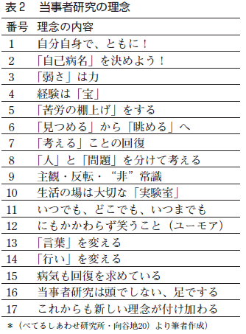
Philosophy of Tojisha Kenkyu
1 Study yourself together
2 Let’s create your unique disease name
3 Weakness is strength
4 Experience is treasure
5 Make the problem shelved
6 Not to gaze but to observe
7 Recovery of thinking
8 Separate the problem and the person
9 Subjectivity, Reverse, Counter-common sense
10 Daily life space is an important laboratory
11 Anytime, anywhere, all the time
12 And yet, smile (humour)
13 Change the Words
14 Change the Behaviour
15 Disease also wants recovery
16 Tojisha Kenkyu not by brain but on foot
17 Newer philosophy will emerge further

Slide 5
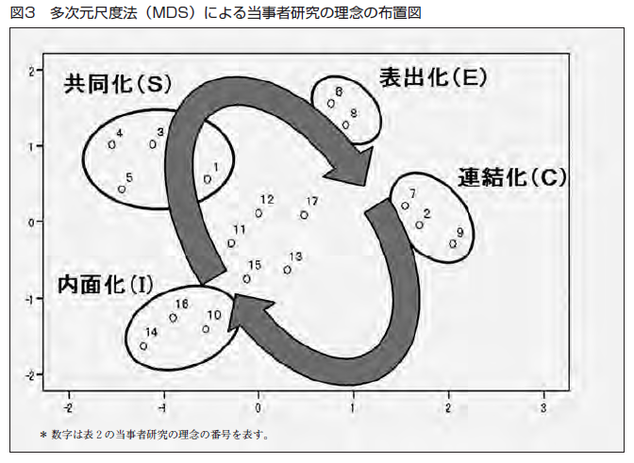
Process of Tojisha Kenkyu as collective discovery by socialization, externalization, combination & internalization (SECI model by Nonaka in Ito, 2011)
Socialization
Externalization
Combination
Internalization

Slide 6
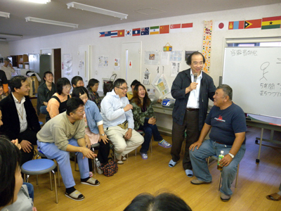
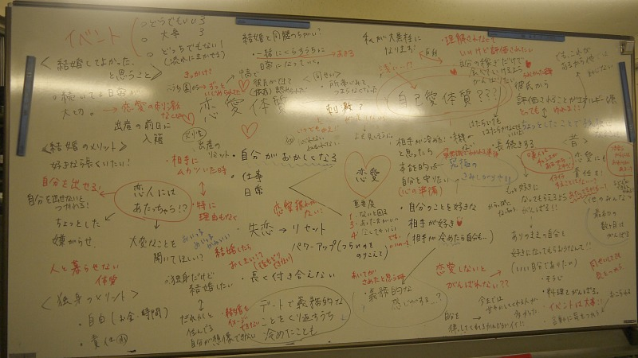
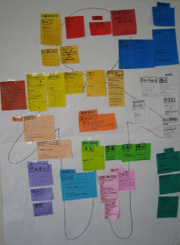

Slide 7
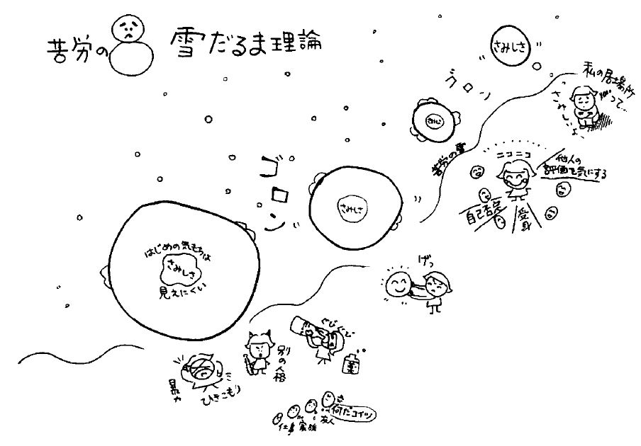
Snowball effect of distress A formulation in Tojisha Kenkyu
Loneliness
I have no place to settle
I am lonely
Rolling
Rolling
The initial
feeling is now
invisible
Smiling with
Fear on
others evaluation
Passiveness, &
Self-negation
Drugs
I hate it!
“Why you do it?”
Friends
Family
Workplace
Violence
Withdrawal
Other
Personality

Slide 8
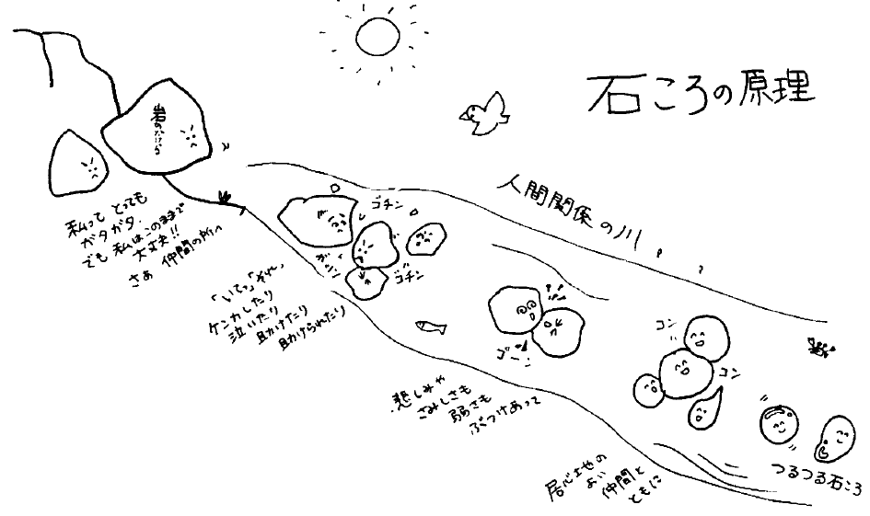
Recovery principle of rolling stones A formulation in Tojisha Kenkyu
River of human relationship
I am a ragged rock,
but I am OK.
Let’s go with peers
“Ouch!”
Fighting,
Crying,
Helping, and
being helped
Sadness,
Loneliness,
Weakness,
Banging
each other
Together with comfortable peers
Polished smooth
stone

Slide 9
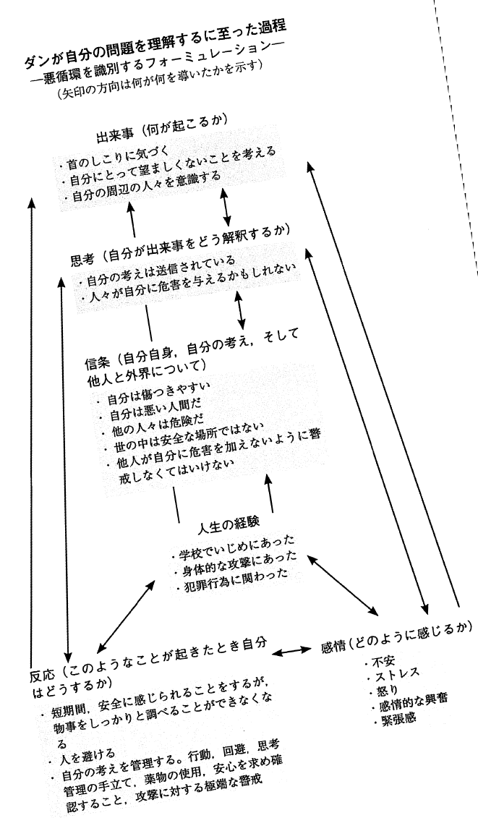
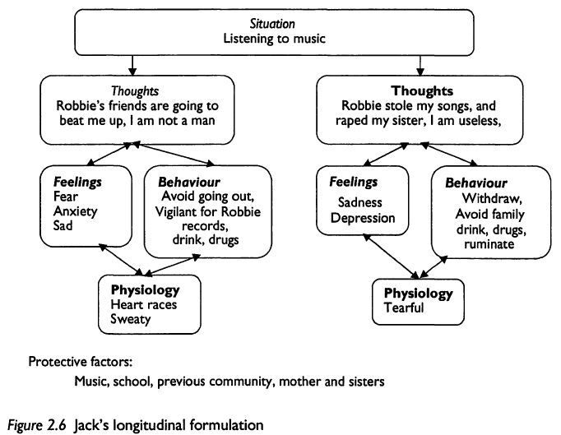
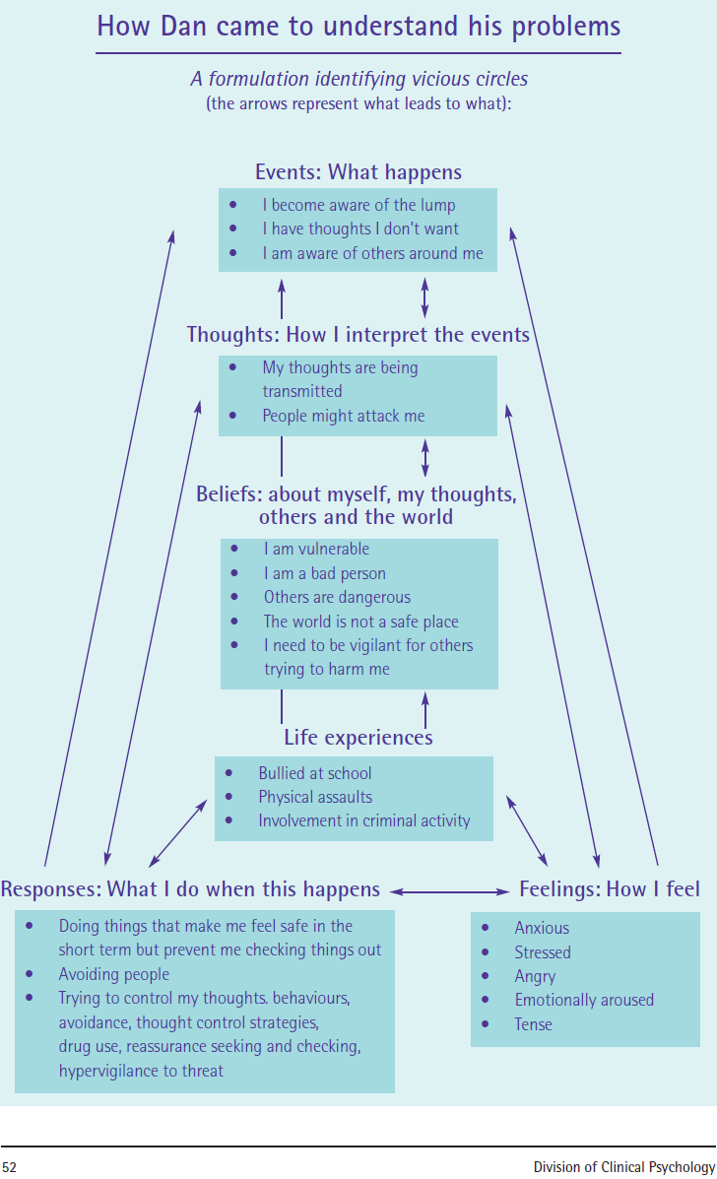
Formulation by UK psychologists and Tojisha Kenkyu in Japan JOHNSTONE & DALLOS 2014 Formulation in Psychology and Psychotherapy (2nd ed) ROUTLEDGE

Slide 10
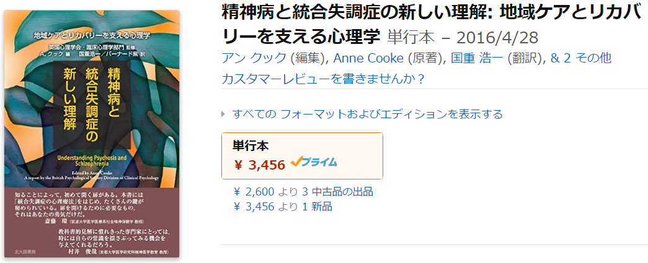
‘Tojisha Kenkyu’ in Japan and ‘psychological formulation’ in UK
Commonalities
Based on dialogue and narrative
Cognitive-behavioural approach
Interactive approach
Visualization of results
Differences
Client- Therapist dichotomy
Cooke 2014 Understanding Psychosis and Schizophrenia. British Psychological Society（A.クック 編 2016 精神病と統合失調症の新しい理解 北大路書房）

Slide 11
Open dialogue in Finland
◎Cook, 2014 Open Dialogue:
Where services use this approach, as soon as someone is referred workers ask for their permission to arrange regular meetings. Meetings could include mental health staff, the person themselves and all those around them including family members, employer, neighbours and friends. The meetings offer a chance for all those involved to listen to each other and take seriously each other’s understanding of what is going on. All decisions are made at these meetings. It is reported that within such services, fewer than a third of people are prescribed neuroleptic medication.
◎Saito, T. (2015).
◎Mukaiyachi (2015).

Slide 12
‘Tojisha Kenkyu’ in Japan and ‘open dialogue’ in Finland
◎Commonalities
Community based
Group based
Dialogical process
Opening of information of weakness
Equality between professionals and nonprofessionals
Collective approach
◎Differences
Family based vs. Non-family based
Open dialogue within vs. open to audience

Slide 13
Limitation and Conclusion

